Slide 1
CubeSat Mounting Fixture
NORTHERN ARIZONA SENIOR DESIGN TEAM:
RICHARD CAMPOS – PROJECT MANAGER
JACQUELINE FONSECA – WEBSITE DESIGNER
ZACKARY RETZLAFF – CLIENT CONTACT
JACOB BELIN – BUDGET LIAISON

Slide 2
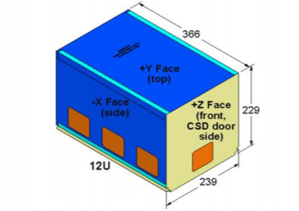
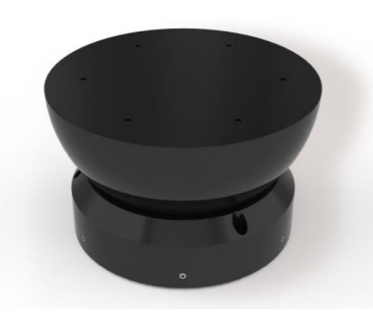
Project Description
The proposed effort will design a mounting fixture for a 12U CubeSat so a frictionless environment can be achieved on an Air Bearing Test Stand.
The design must:
Refocus Center of Gravity*
Limit Tilt Degree
Be Adjustable in Three Axes*
Be Adjustable to Different Payloads

Slide 3

Client Information
General Atomics (est. 1955)
  Division of General Dynamics
  Leading resource for energy applications to laser to automated flight technologies.
Affiliated Companies and Groups
  GA-Aeronautical Systems, Inc.
  GA-Systems Integration
  GA-Electromagnetic Systems
Electromagnetics Systems (EMS)
  Systems for electromagnetic aircraft launches and recovery systems
  Develop pioneering technology for defense, aero, and energy applications
  Commercial technology for electronics, transportation, and production

Slide 4
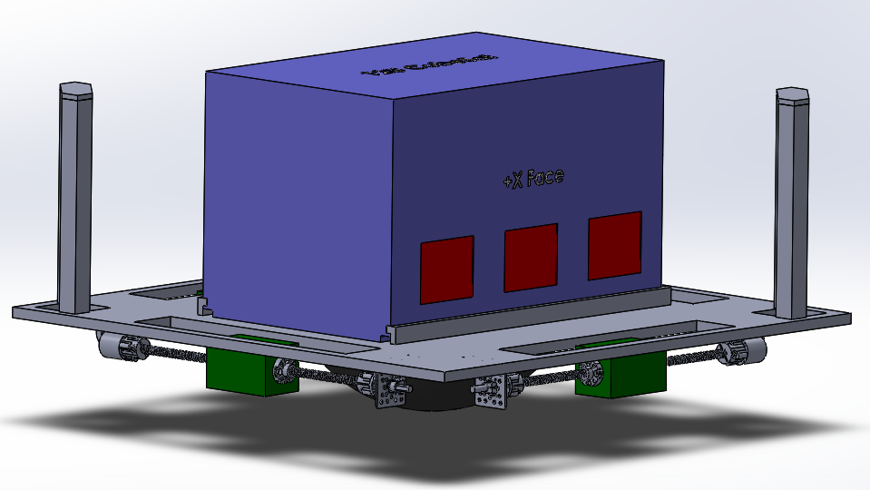
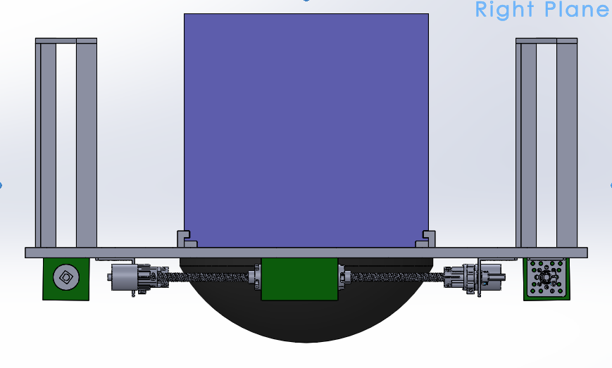
Design Description
Repurposing air wrench to rotate lead screw, (pneumatic system)
Displacing CG in XY plane made possible by rail assemblies parallel to platform
Moving CG in vertical (z-dir) using vertical rails, (redesign in progress)
Secure CubeSat to platform via L-hooks which seat on pre-fabricated tabs
Air bearing sphere attached with fasteners
Arduino program and battery will be enclosed inside the hollow sphere
Notes:
Describe the current state of your design and provide CAD models to help in visualizing your proposed solution. Describe how the system functions

Slide 5
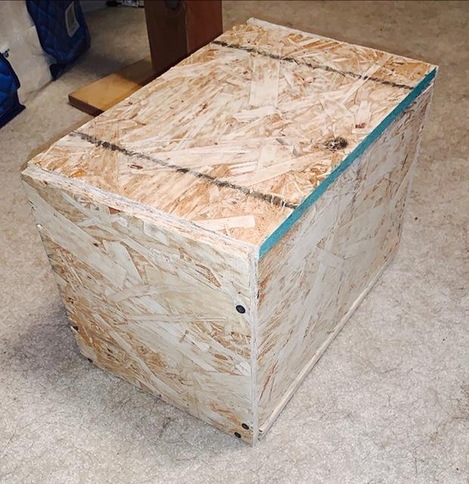
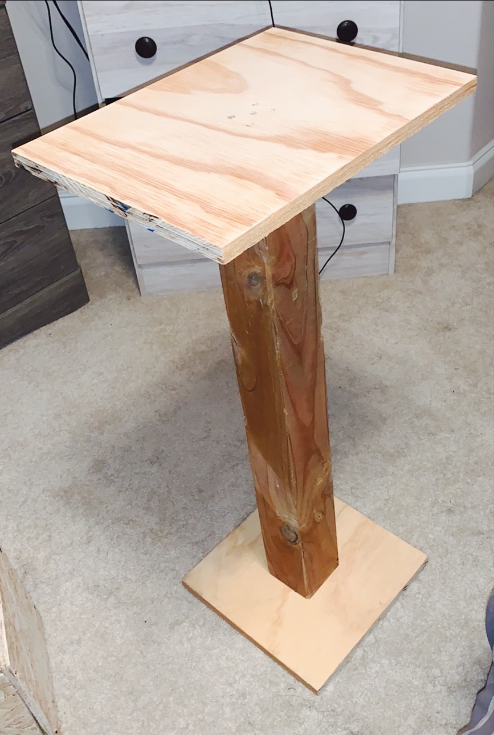
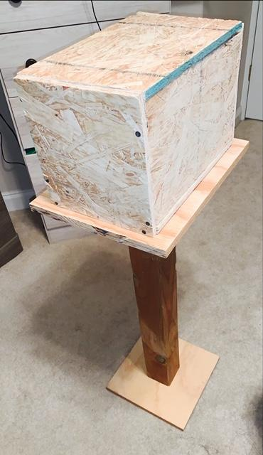
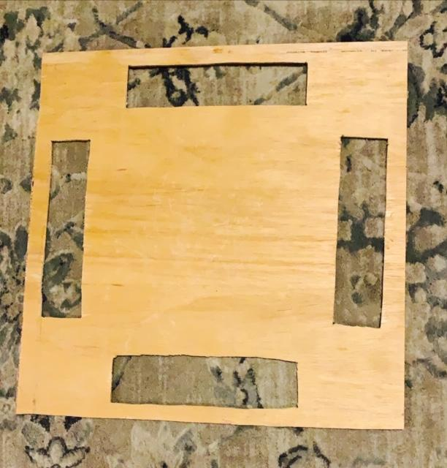
Current State of System: Overview
Current prototype is broken down in subsystems to facilitate team members working on components simultaneously
Notes:
-Show image of stand, cube sat model, and wooden cut out, then say our current state is broken down by subsystem

Slide 6
Subsystem: Programming
Each team member completed different aspects of the Arduino code for the fixture
  Richard: wrote subprogram to detect tilt in system and is researching integration of MATLAB and Arduino software
  Jackie and Jacob: worked together on refining center of gravity calculations In MATLAB
  Zack: worked on using force sensors to detect center of gravity of the system

Slide 7
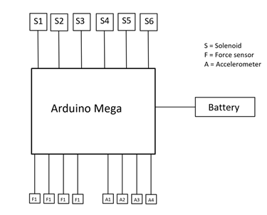
Subsystem: Electrical
Switched from Uno to Mega
Decreased number of motors and solenoids
  Reduction of these components decreases cost
Added accelerometers
  Adds verification of self-balancing and 35° tilt angle requirement

Slide 8
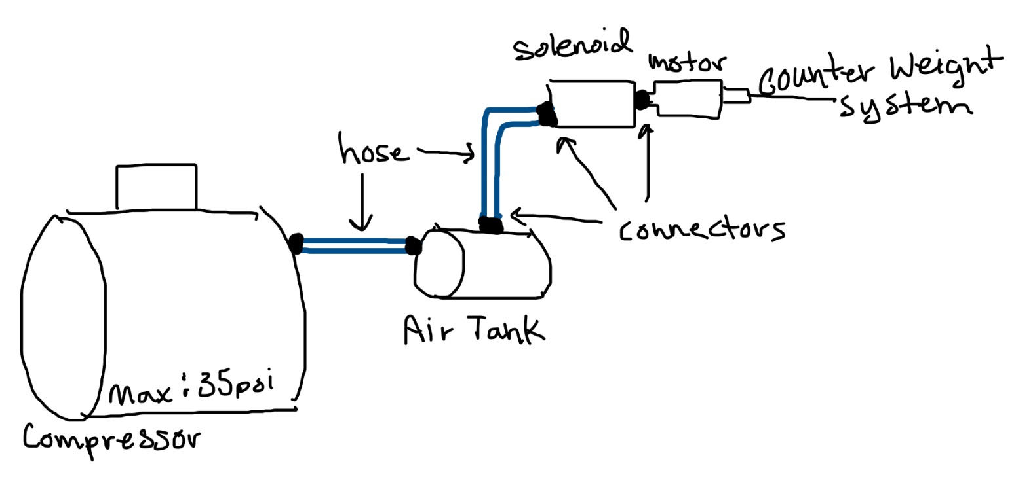
Subsystem: Pneumatic
Pneumatic powers the counter-weight system
Total set up
  Solenoid & Motors on the fixture
  Rest is external
Allows to decrease weight, size, and unnecessary complex parts

Slide 9
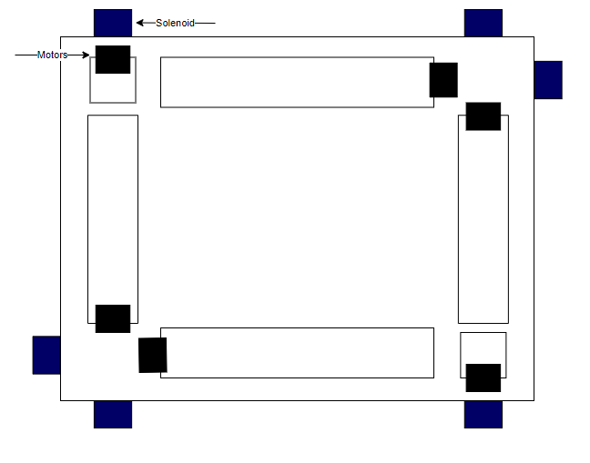
Pneumatic: Set Up
Each Counter-Weight system has its' own motor and solenoid
The code is being programmed to calculate the time needed for each solenoid to be open
The compressed air will be attached to each solenoid individually

Slide 10
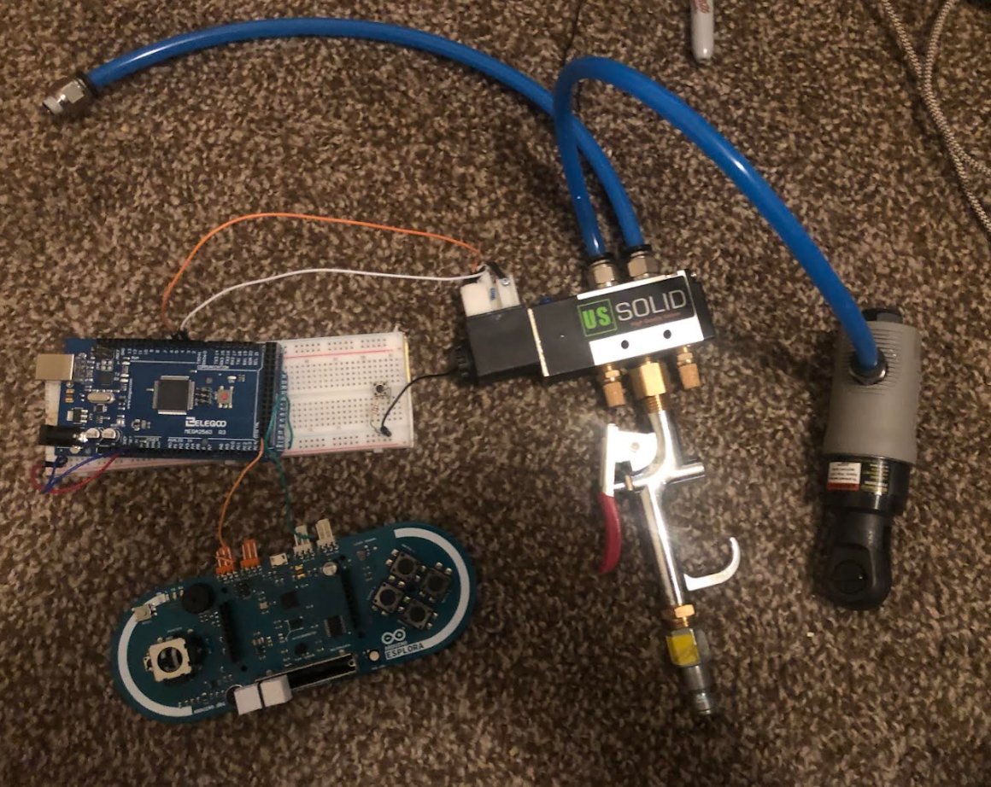
Pneumatic: Current Prototype
Hosing
Solenoid
Arduino
Motor
Arduino Esplore
Valve

Slide 11

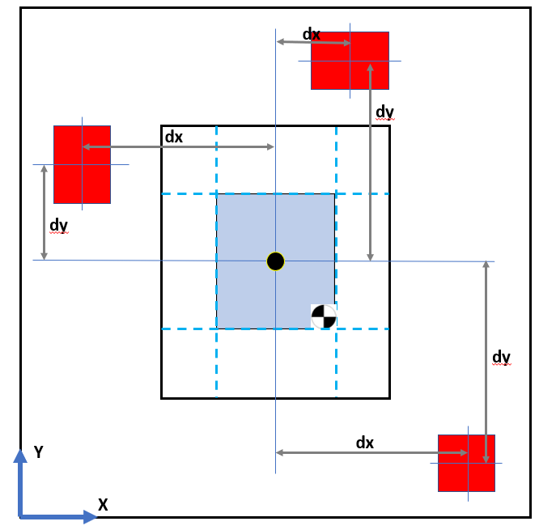
Subsystem: Counter-Weight
Assume max displacement for CubeSat CG (blue)
Assume max counterweight travel distance is length of particular CubeSat edge
From analysis, we assume symmetry of device negates all other moment components
Counterweight mass - 5 lbf
Lead Screw Length - equal to edge

Slide 12
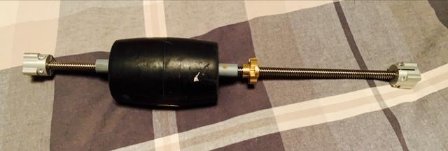
Counter-Weight: Current Prototype

Slide 13
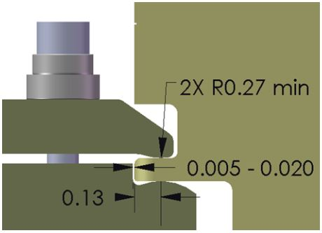
Subsystem: Securing Mechanism
Originally, the team was going with the clamping mechanism given to us by General Atomics in the CSD document
After considering machining costs, we decided to go an alternative route that would hold the CubeSat in place without throwing off CG calculations

Slide 14
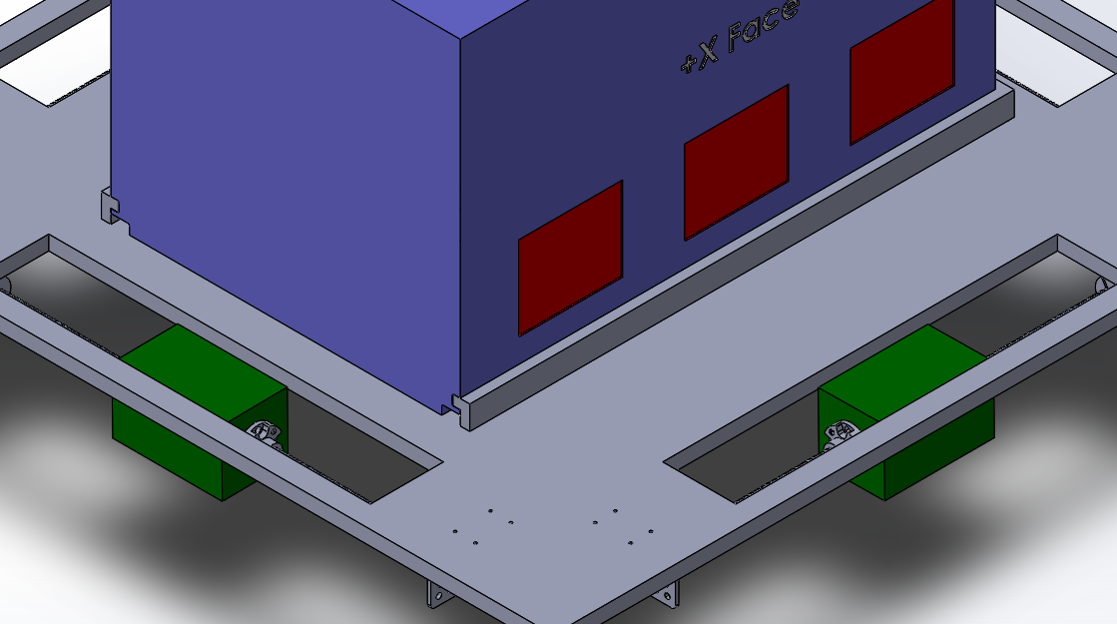
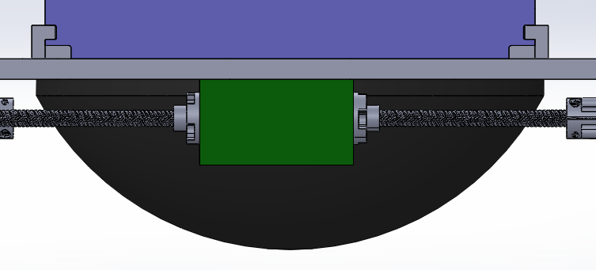
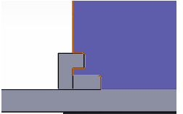
Subsystem: Securing Mechanism

Slide 15
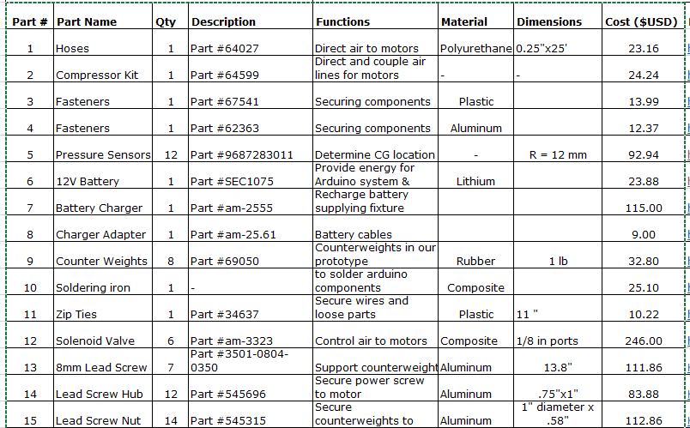
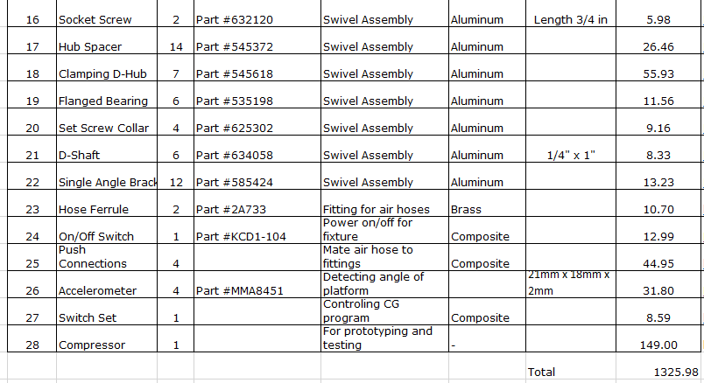
Bill of Materials
Target Budget - $2600.00
Current Expenditure - $1326

Slide 16
Implementation Plan: Manufacturing
Build Each Sub-System Separately
Arduino/Electronics: Richard - In progress, finish by October 11
Pneumatic System: Jackie - Waiting on parts to come in, finish by October 25
Counter-Weight System: Jacob - Waiting on parts, finish by October 25
Securing Mechanism/Platform: Zack - Waiting on parts, finish by October 19
Connecting each sub-system: Everyone
Attach each running sub-system: Electronics, Pneumatic, Counter-Weight - October 30
Connect all to fixture - October 30
Notes:
TBD depending on when objects come in, people are working separately on different parts of the code, but still in concert with each other

Slide 17
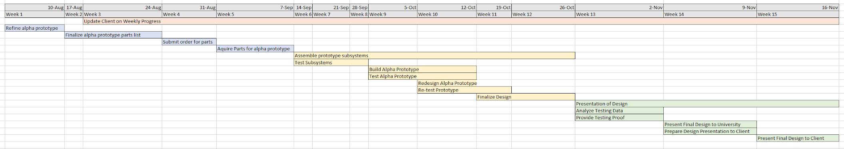
Implementation Plan: Future Tasks
Notes:
Due to delays in parts orders, the semester schedule had to be adjusted to accommodate this setback. Even with the changes, the team still anticipates the successful completion of a working prototype to present to our clients.

Slide 18
Testing Plan
The team plans to test each subsystem separately and test the completed prototype together thereafter
  Programming
    Force Sensors (Arduino) COMPLETED
    Accelerometers (Arduino) COMPLETED
    Center of Gravity calculations (MATLAB) IN PROGRESS
  Electrical
    Relaying information from sensors to compute and back to the motors IN PROGRESS
  Pneumatic
    Motors IN PROGRESS/FUTURE
  Counterweight FUTURE
  Securing Mechanisms FUTURE
Notes:
In order to ensure each subsystem works properly, we need to perform tests. The force sensors were tested using wooden dowels on a platform to ensure the force was all concentrated to the sensor. When tested with a five pound weight, the program read exactly 22 Newtons, which is approximately 5 pounds. The accelerometers were tested by using an LED light. This LED light was red when the angle of tilt exceeded 35 degrees and green when it was under. This is one of our engineering requirements, to limit the angle of tilt to 35 degrees in all axes.

Slide 19
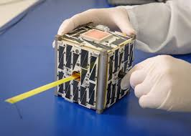
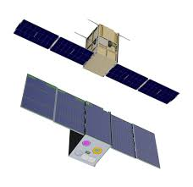
Questions?
https://www.google.com/url?sa=i&url=https%3A%2F%2Fspaceflightnow.com%2F2015%2F10%2F16%2Fnasa-to-fly-cubesats-on-three-new-commercial-launchers%2F&psig=AOvVaw3IiEjWCPcim8QH78k-17Xy&ust=1601444892899000&source=images&cd=vfe&ved=2ahUKEwic04Gh1Y3sAhUBZawKHVKECq8Qr4kDegUIARDiAQ
https://www.google.com/url?sa=i&url=https%3A%2F%2Fwww.adcolemai.com%2Fsmall-satellites%2F&psig=AOvVaw0cSlBw9lTuXbkAlyHuaVhg&ust=1601445068012000&source=images&cd=vfe&ved=2ahUKEwjXt8L01Y3sAhVXf6wKHWtuDgwQr4kDegUIARDgAQ
Notes:
Just showing how compact these satellites are and how they look fully deployed

